Slide 1
ELEC 522 Project 2
Aedan Cullen

Slide 2
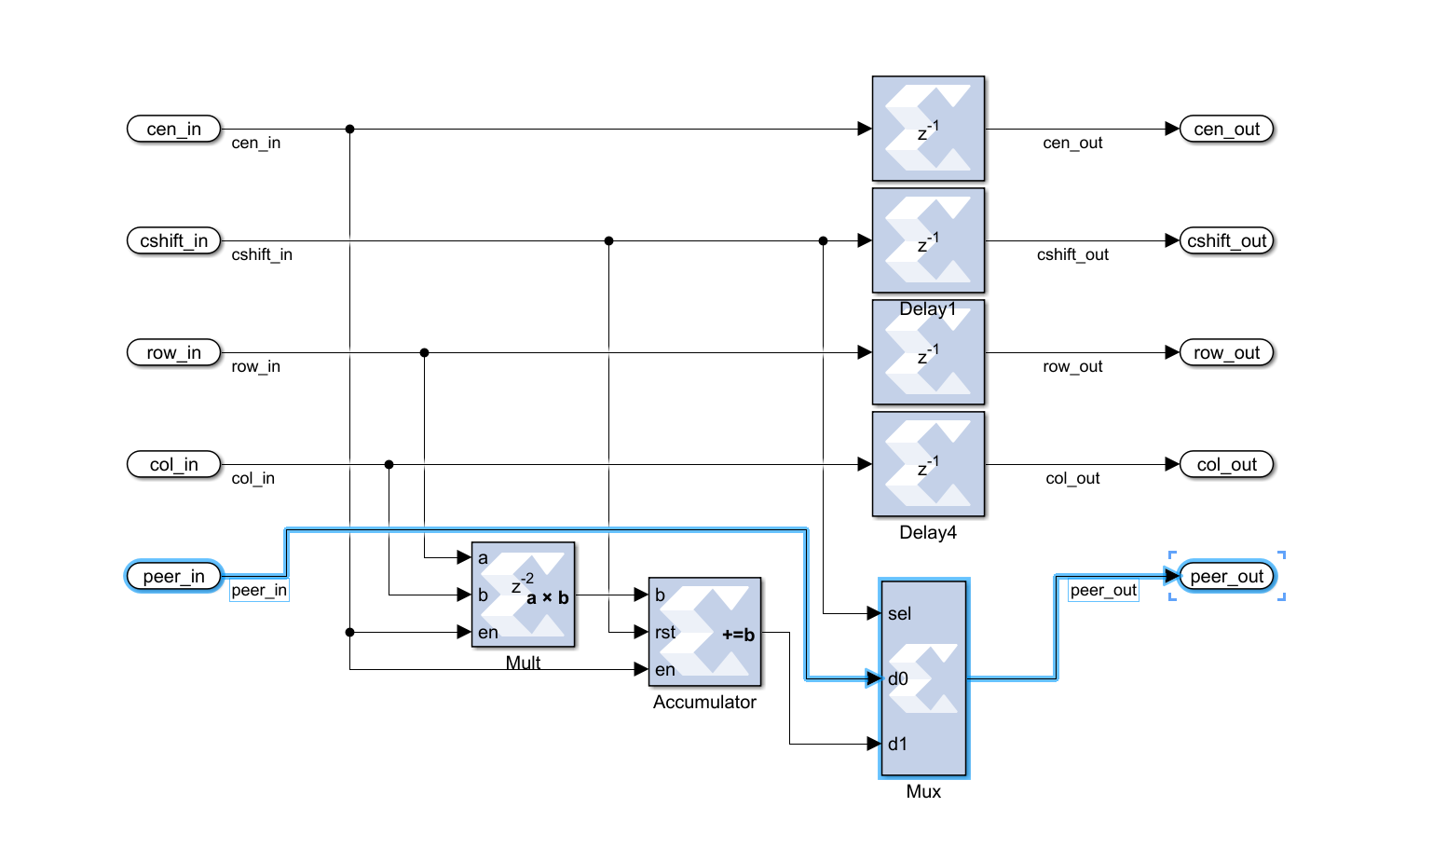
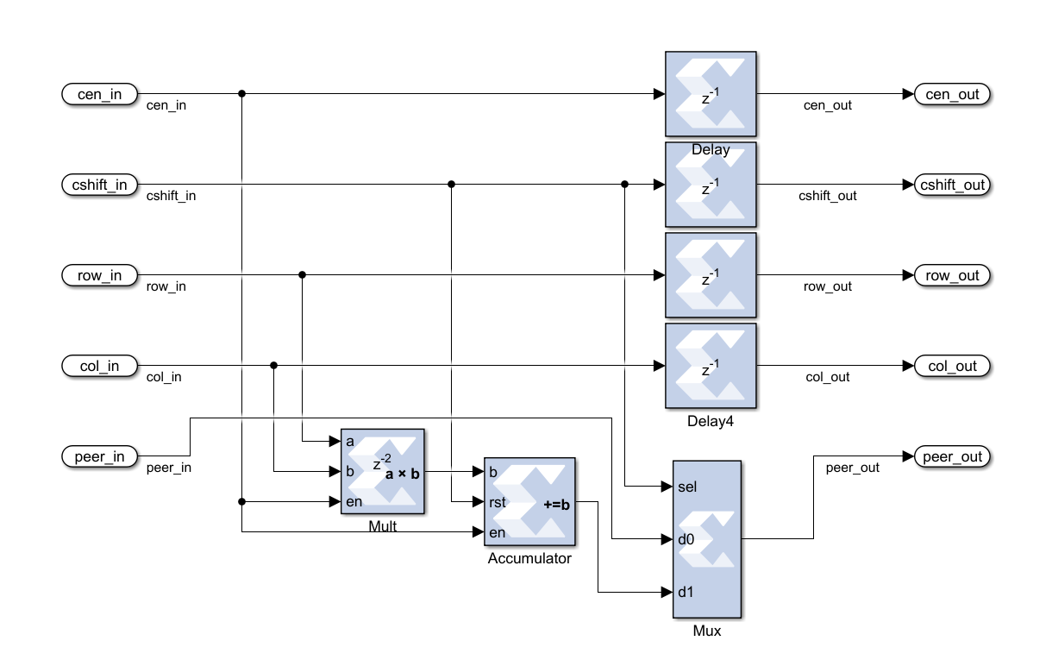
Processing element design

Slide 3
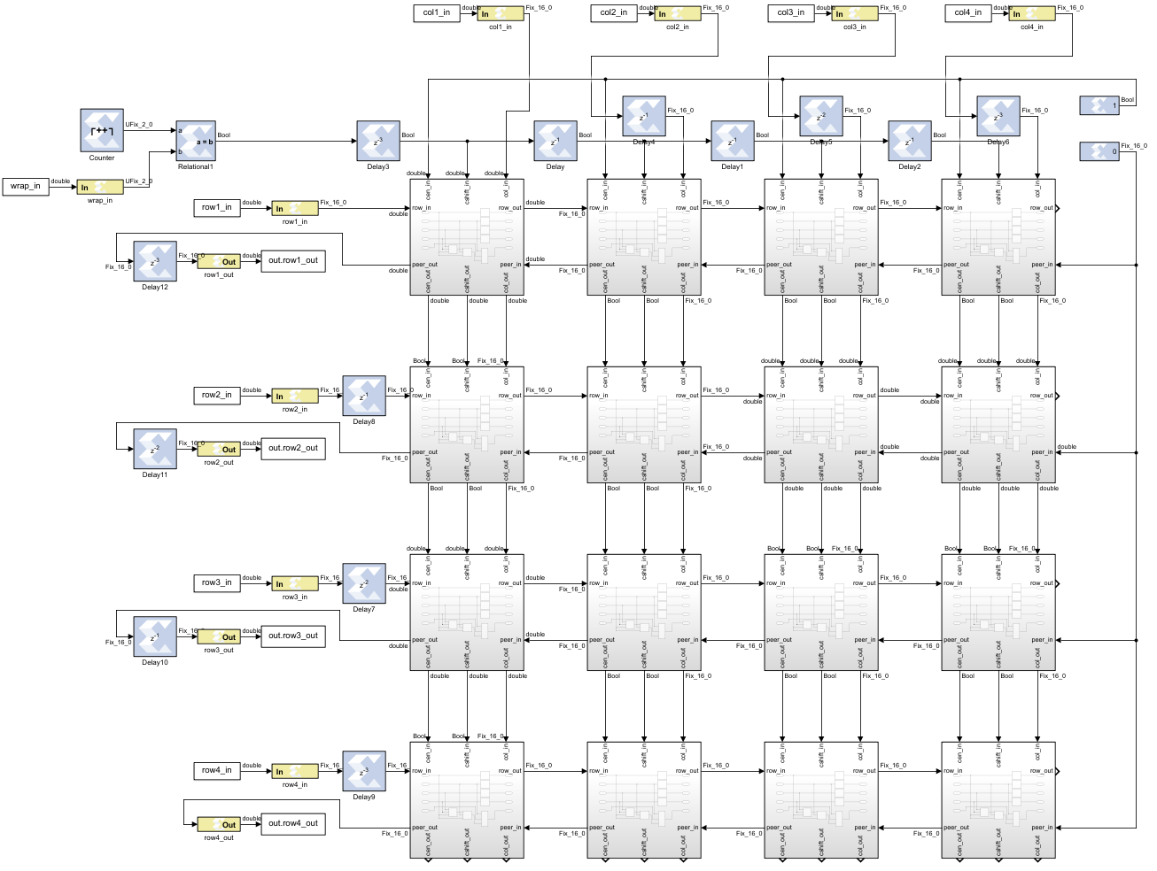
Array organization

Slide 4
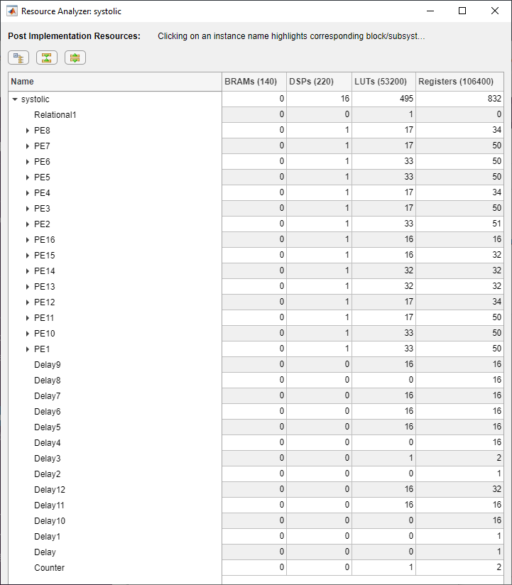
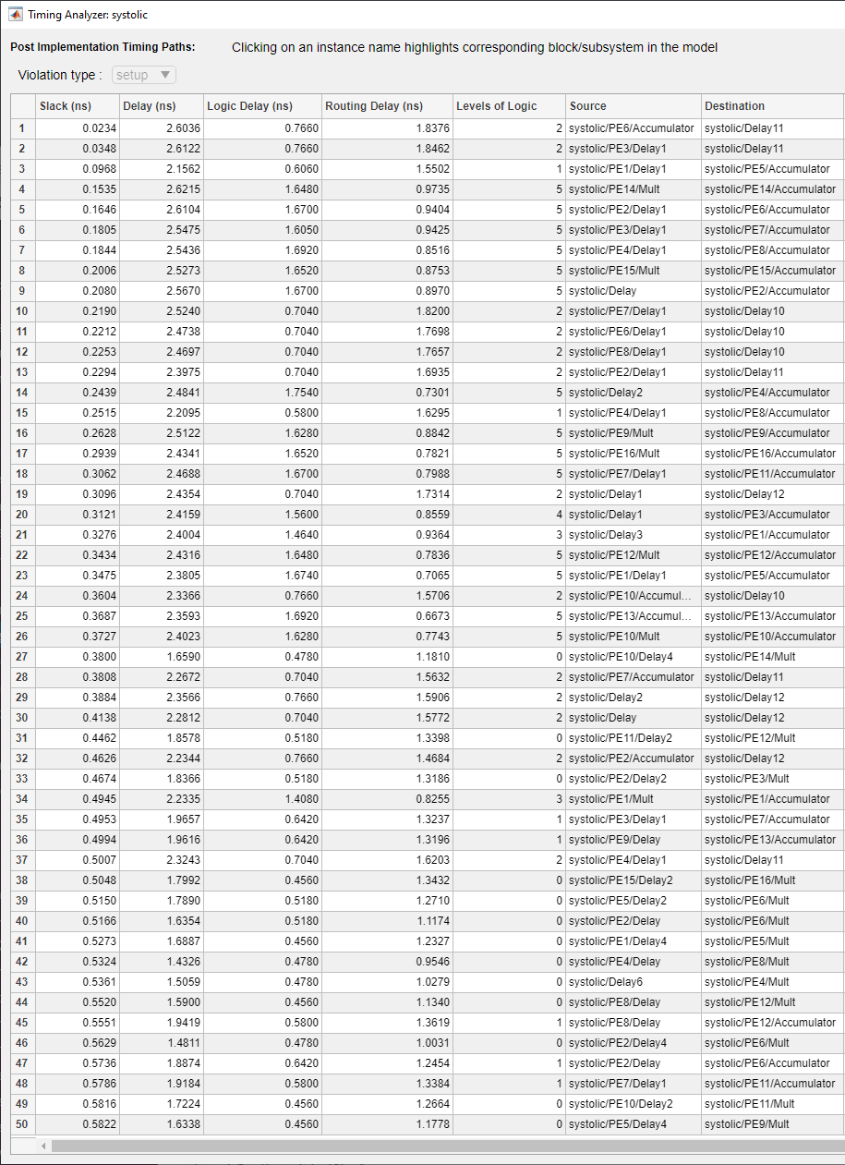
Resource utilization
16 DSPs, 495 LUTs, 832 registers
Maximum clock frequency
~364 MHz (2.75 ns clock period)
Pipelining
Each processing element performs multiply and accumulate in parallel each cycle.
Multipliers are pipelined with latency 2.
9 clock cycles are needed from the time the first elements are shifted in to the time the first complete column of the result is ready.

